Slide 1

CAR EVALUATION
Using Self-organizing Feature Map

Slide 2








Price
Maintenance
Cost
Doors
Passengers
Luggage
Capacity
Safety
Very Good
Good
Acceptable
Unacceptable

Slide 3
Data Set
Car Evaluation Data Set
UCI Machine Learning Repository
1,728 Instances
7 Attributes

Slide 4
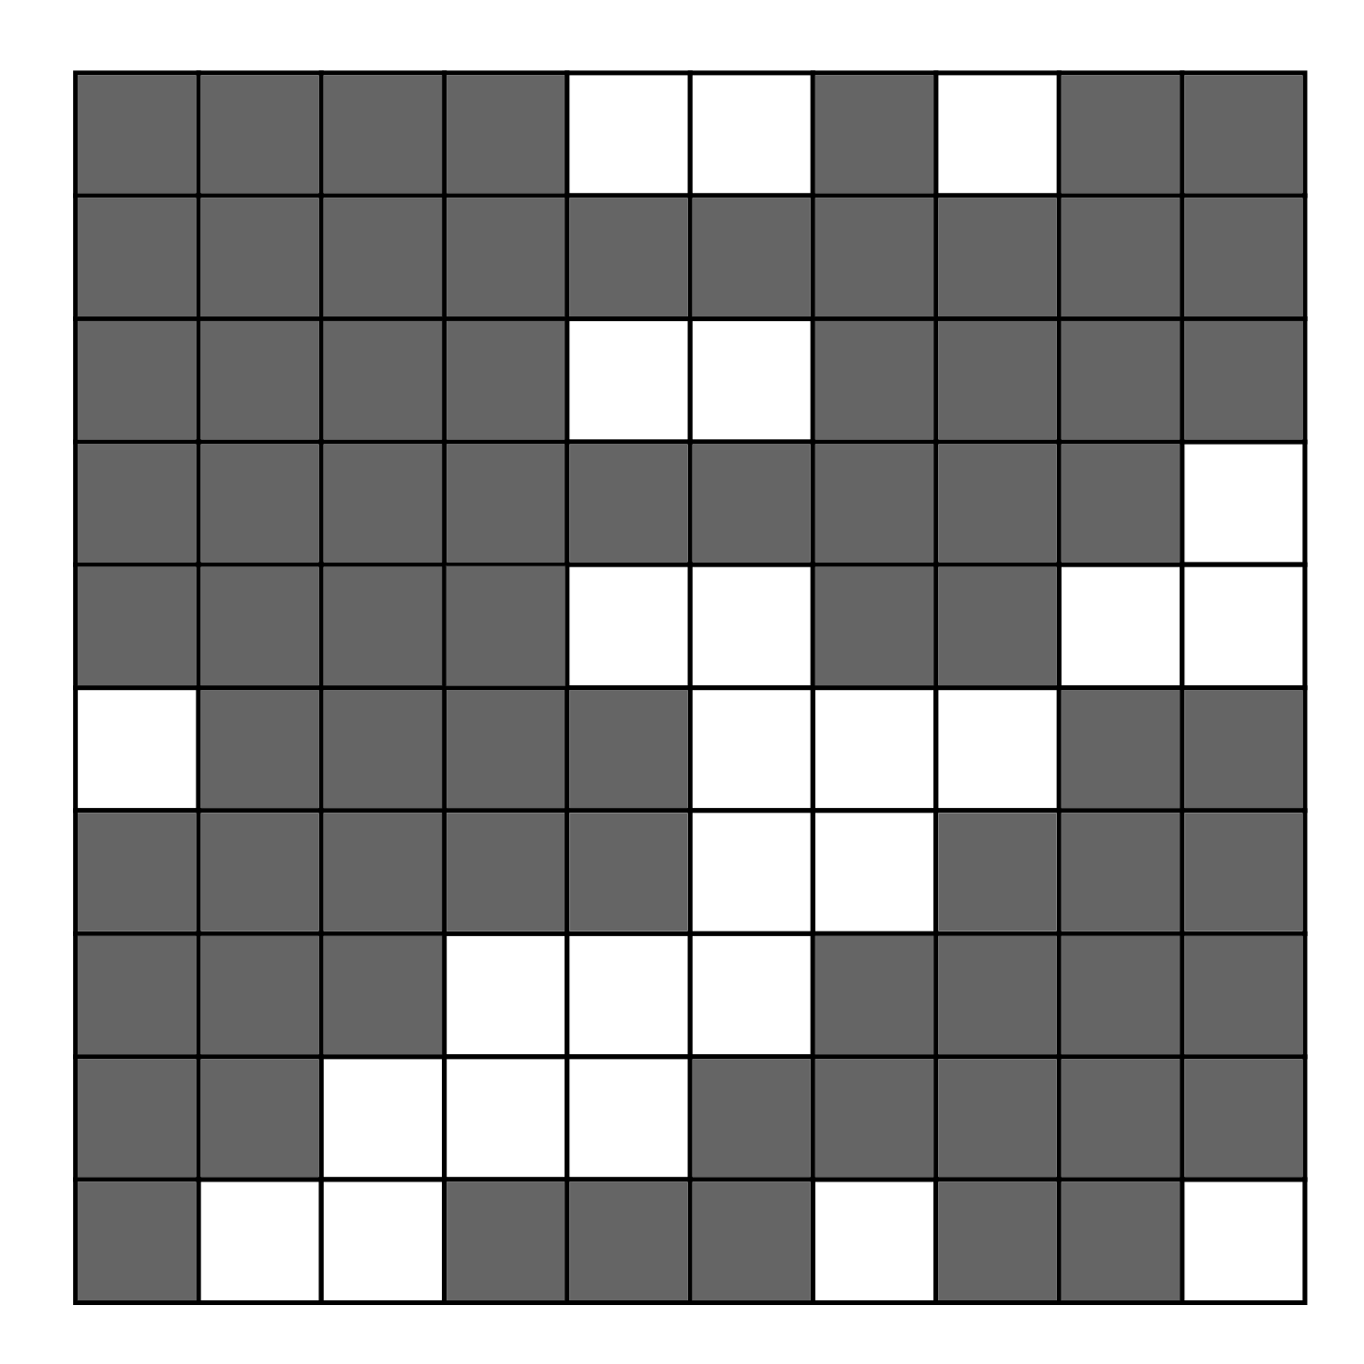
Model
10 x 10
Competitive
Layer

Slide 5
Training
Training
10, 000 Iterations
0.0000001Learning Rate
French Hat Function

Slide 6

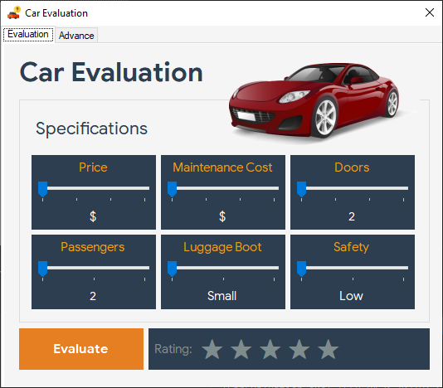
Demo

Slide 7
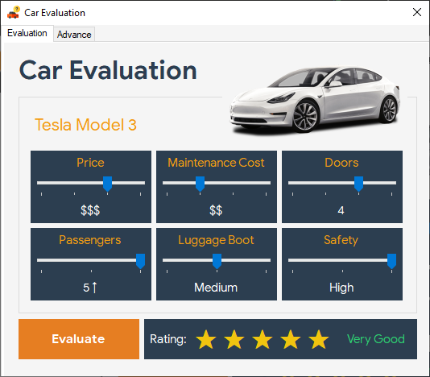
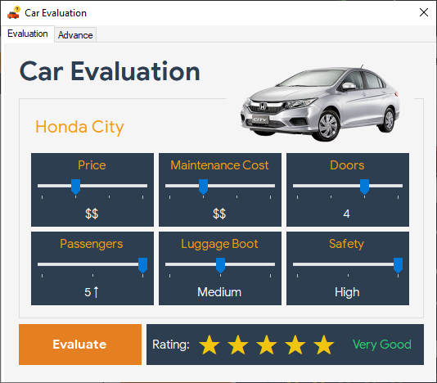
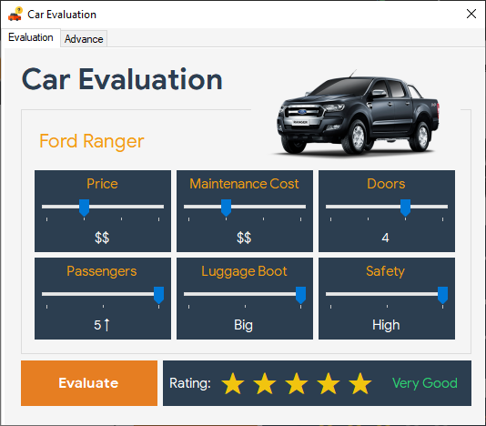
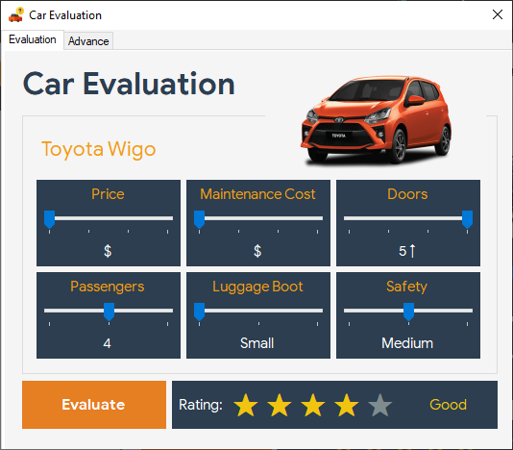
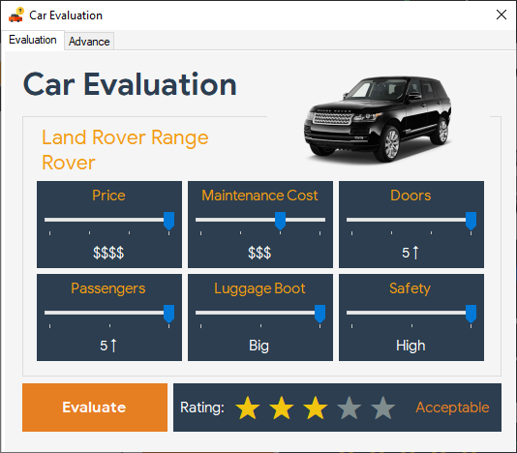
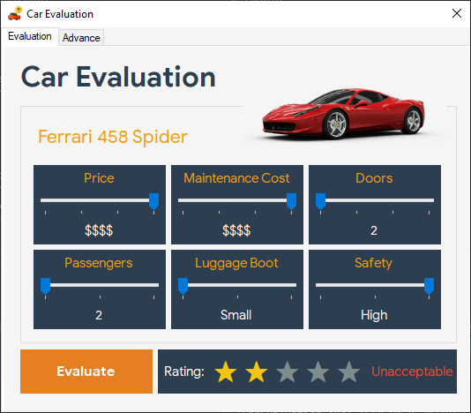
Results

Slide 8
THANK YOU!
End

